Slide 1
Week8 Activities
Attacks
Tevin Herath

Slide 2
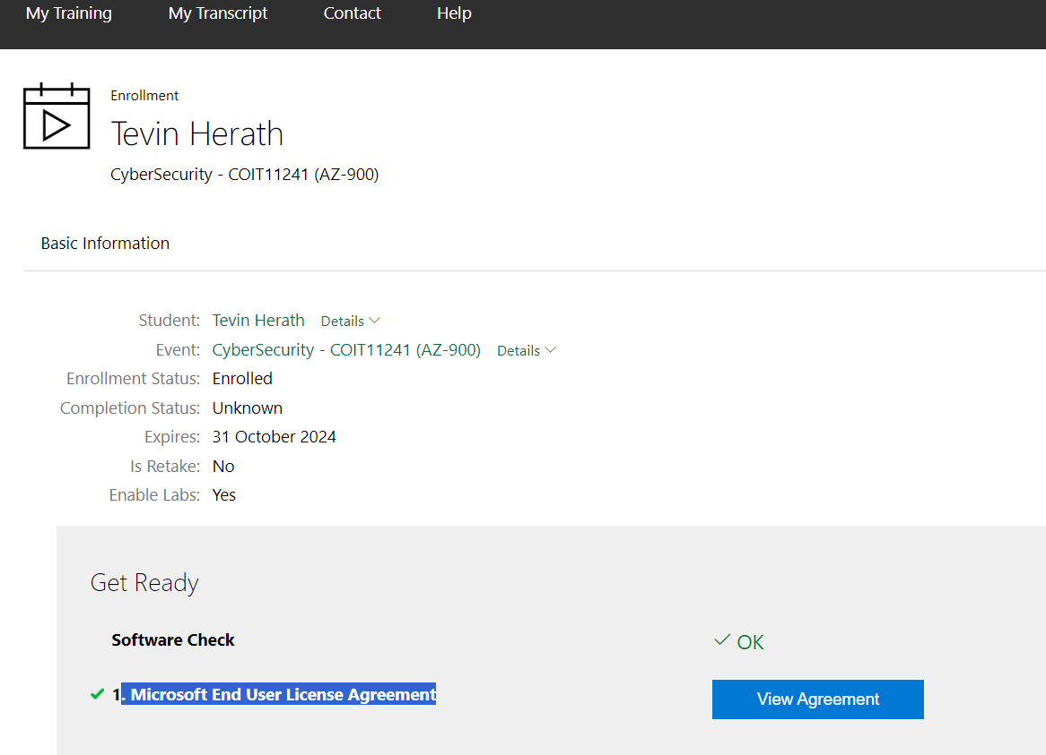
Registered a Microsoft Learn On Demand account with Skillable

